Slide 1

OMNOMNOM: Machine-Assisted Cooking
Miriam Cha, Michelle Deng, and Melih Elibol

Slide 2
Outline
Motivations
Objectives
Preliminary Results
Paper Prototype
User Study
System
Next Steps

Slide 3
Motivations
Cooking is one of the essential human skills
Compared to prepackaged and most restaurant meals, homemade meals are healthier, economical, and give more control
Unfortunately, frequency of home cooking for younger generation has significantly decreased
Perceived to be too stressful and time-consuming, therefore not worthy of the trouble
Can we bring back old fashioned homemade meals?

Slide 4
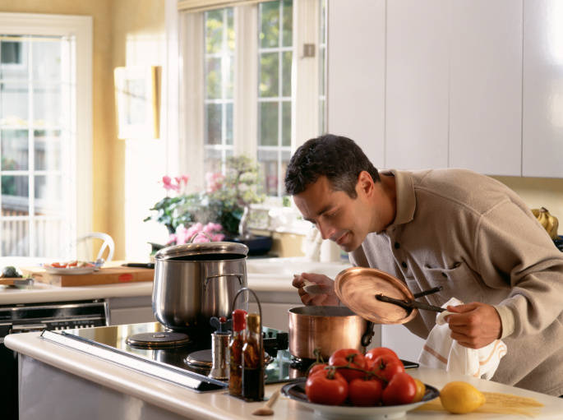
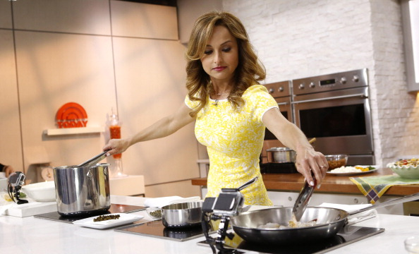
Objectives
Investigate the role of homemade meal
Present our experiences seeking to develop a machine assisted cooking interface for novice cooks
Our interface focuses on reducing cognitive load by:
Providing a user friendly curation of a recipe
Keeping track of ingredients
Notes:
- Investigate the role of homemade cooking through reference searches and user study

Slide 5
Preliminary Results
Designed initial paper prototypes
Conducted user studies to analyze challenges in novice cooks
Identified common challenges
Started building a system

Slide 6
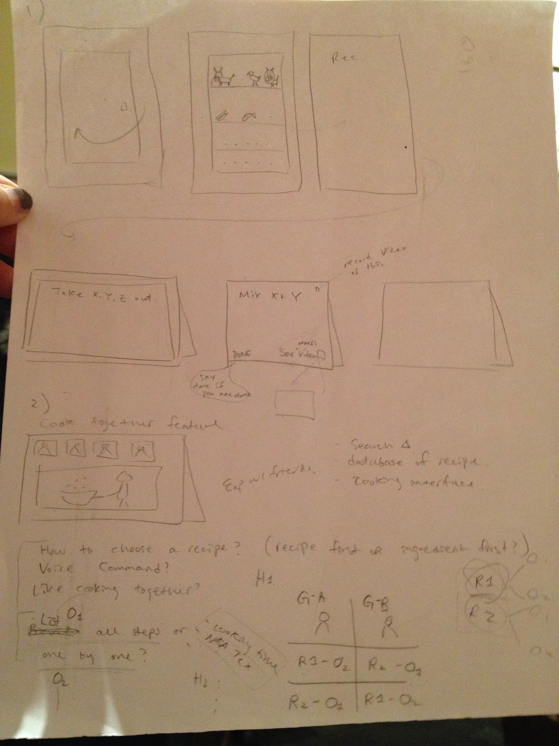
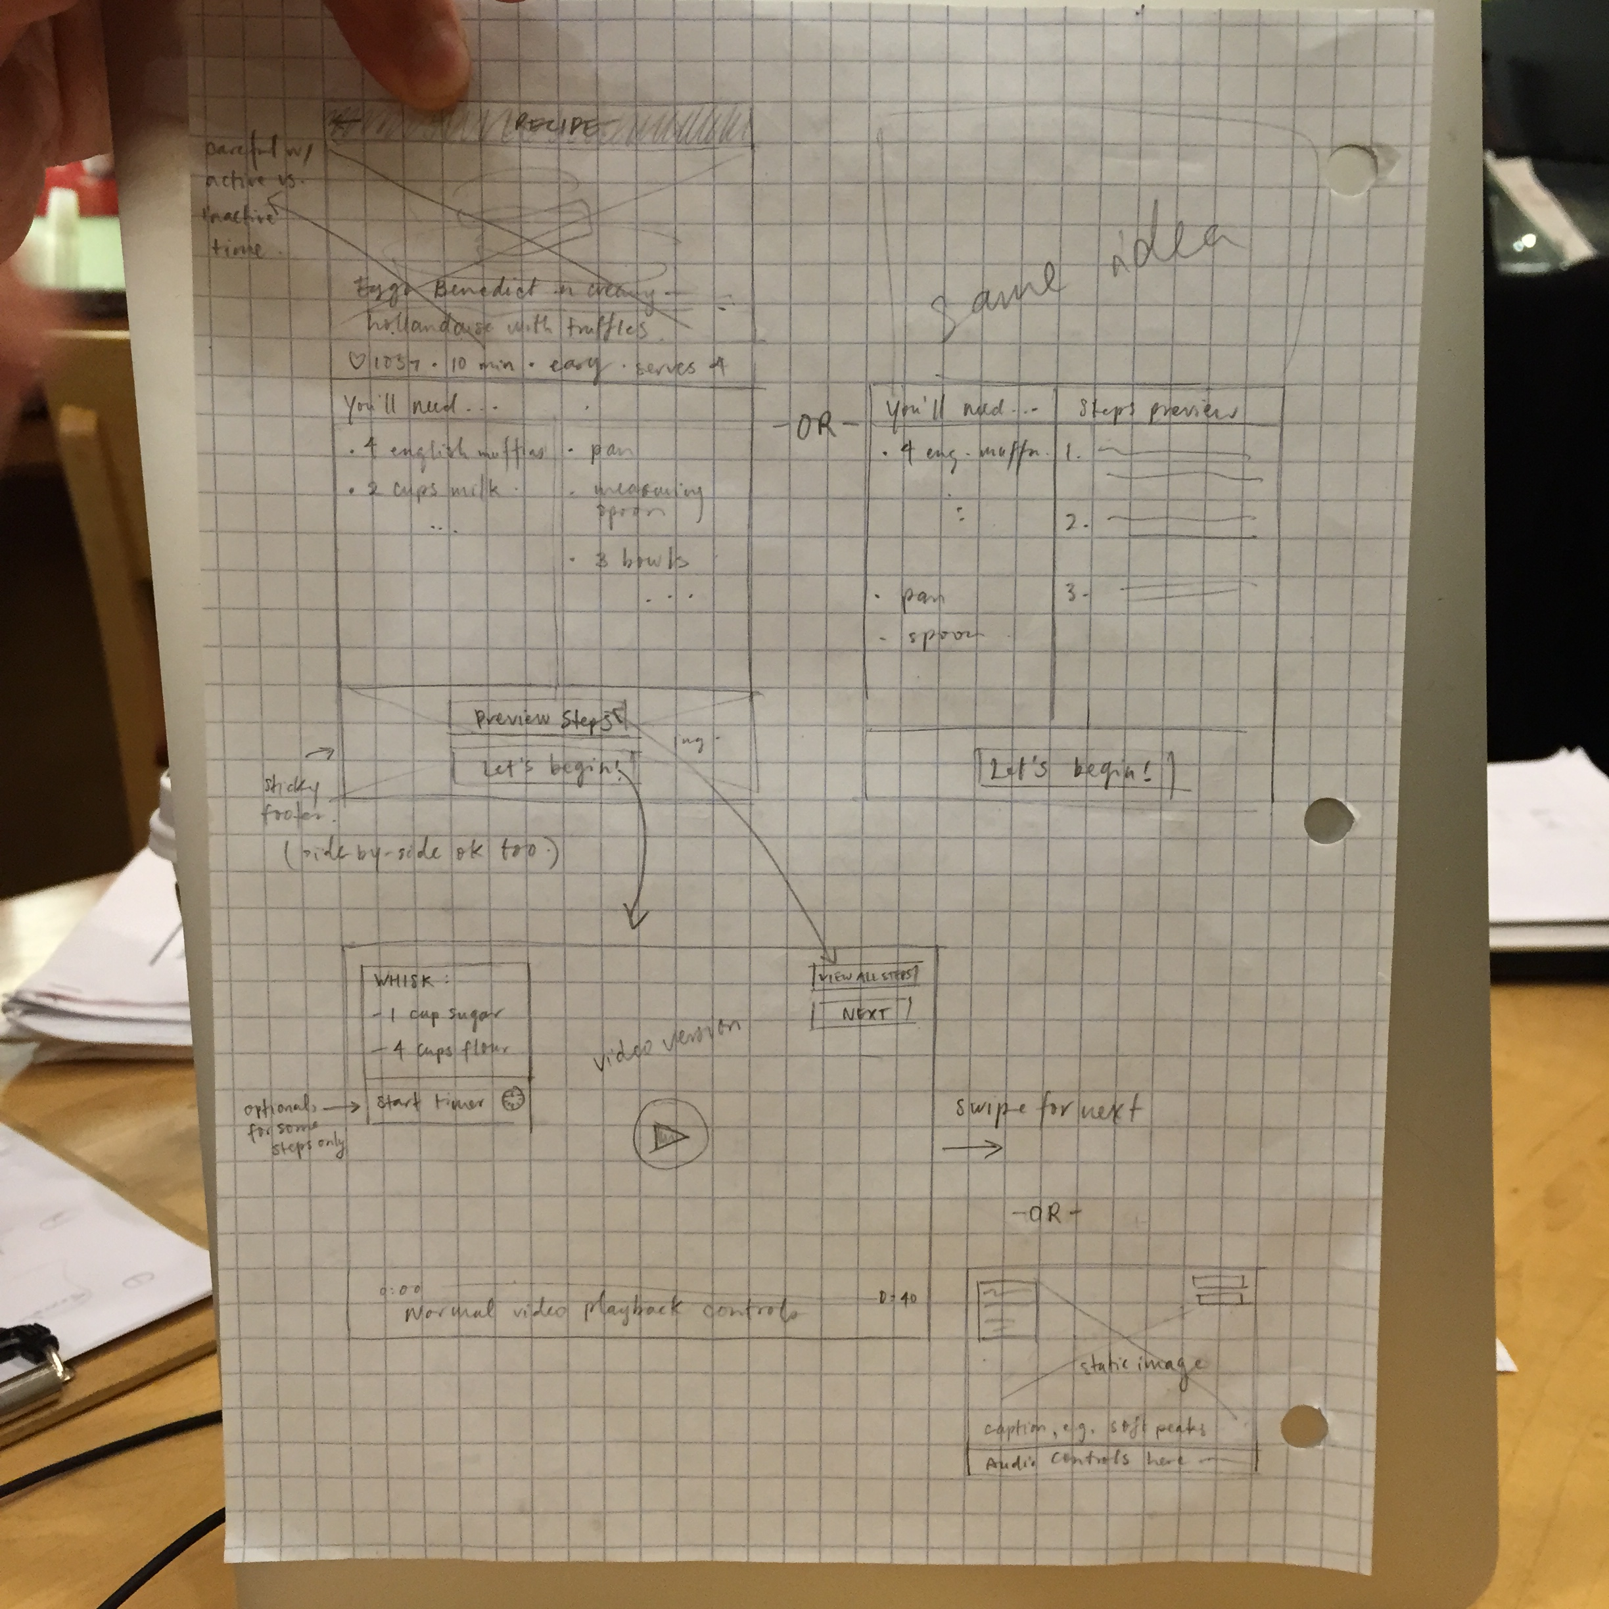
Initial Paper Prototypes

Slide 7
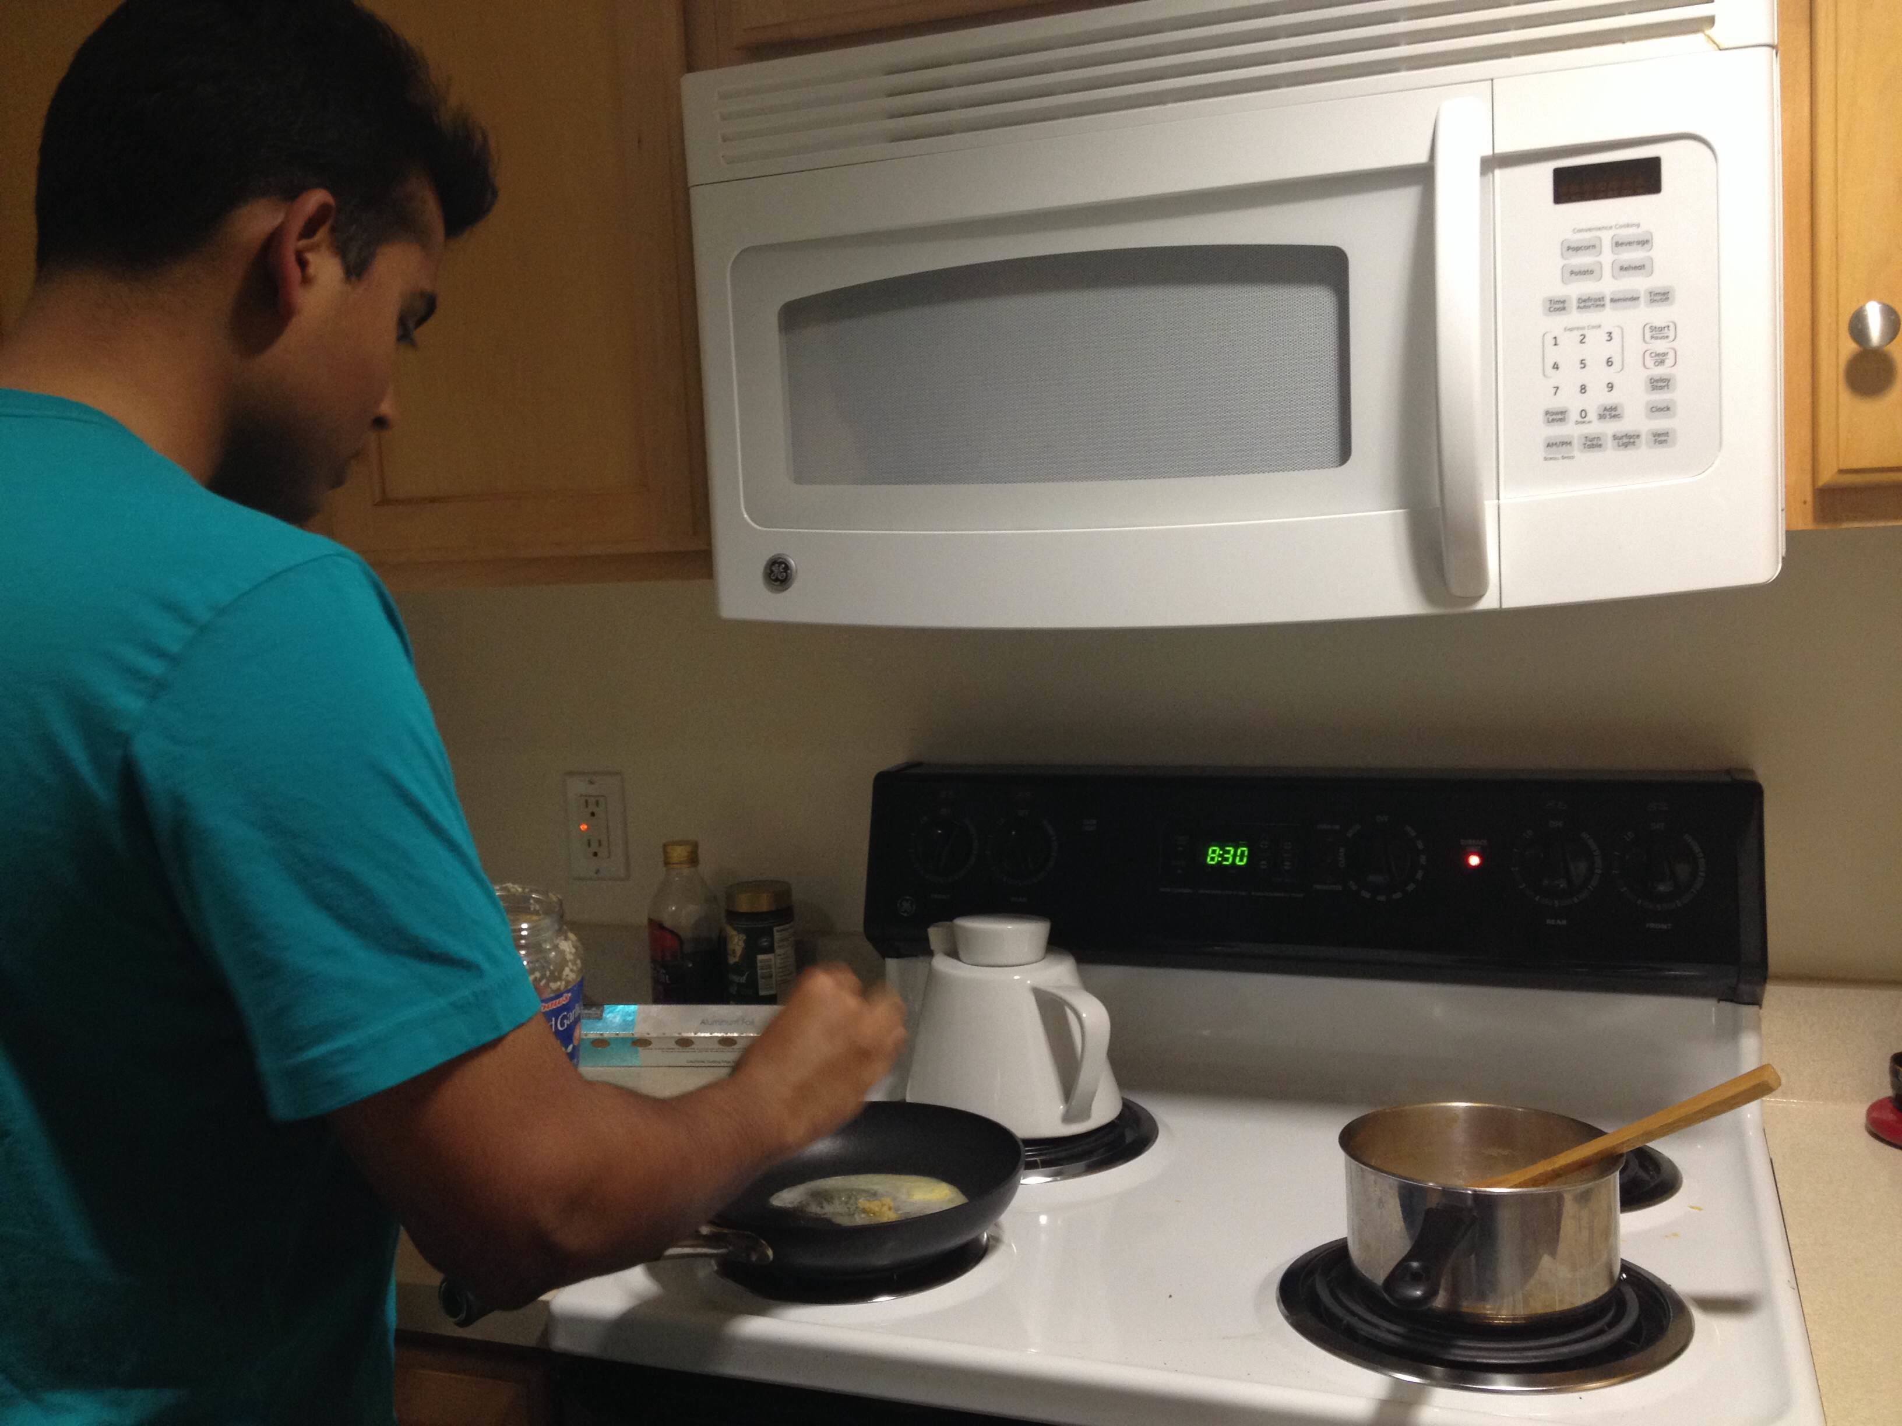
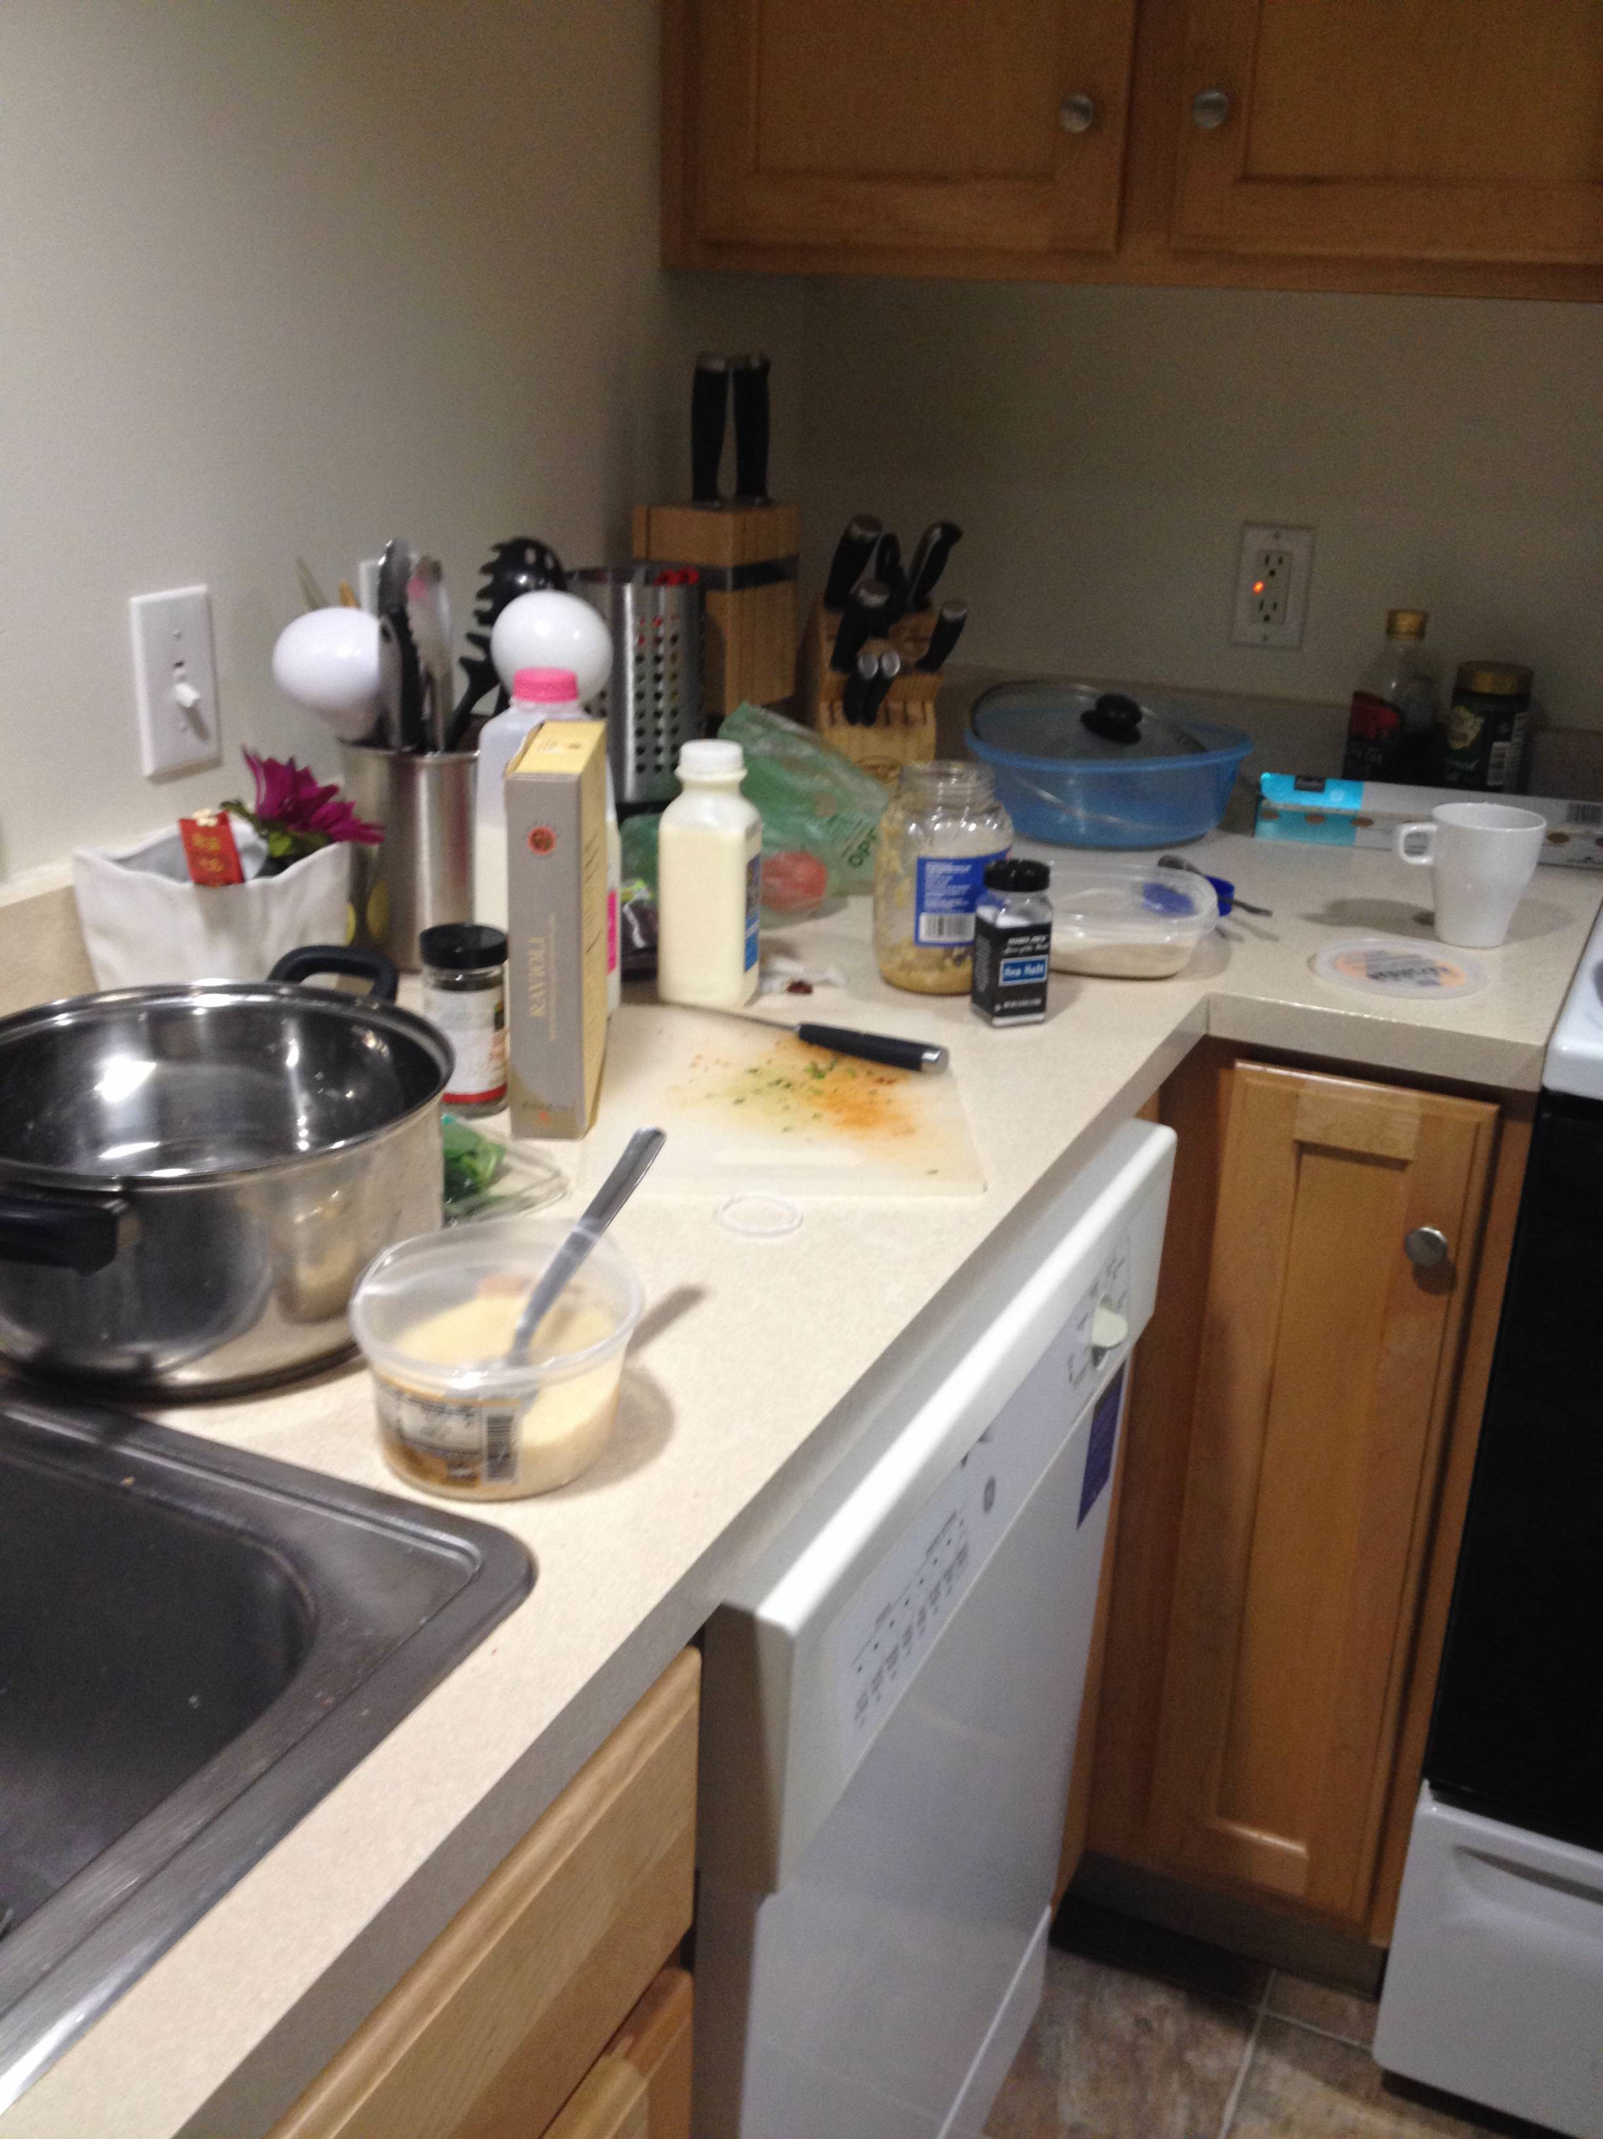
User Study
Observed three subjects
Each subject is asked to cook a dish that he/she has never made before
Asked subjects to narratively describe the process they are taking
Took notes on their behaviors and surroundings while cooking

Slide 8
User Study: Subject 1
Subject 1 had very little experience in cooking
Primary source of meal is delivery or prepackaged food
Key observations
Put all ingredients out and measured ingredients accurately in the beginning but roughly estimated using mugs and bowls while cooking
Unsure of cutting shapes
Used resulting images to decide on a shape
Constantly looked at the recipe (> 20 times)
Missed a step
“I have to constantly read over the paragraphs to see what step I am currently on”
Did not look ahead and mistakenly used up all ingredients when some were needed again in later steps
“My assumption is, unless it’s specifically stated to save some for later, put all ingredients in”; “It would have been helpful if recipe is structured in a form that is easier to see what ingredients are coming ahead”
Multitasking: checking pasta boiling while preparing sauce
Brought heated frying pan to other side of kitchen to read recipe
All ingredients (including the ones that were no longer needed) were kept open and outside
Notes:
miriam

Slide 9
User Study: Subject 2

Slide 10
User Study: Subject 3

Slide 11
Common Challenges
item
Among these challenges, we want to focus on
Curating a recipe
Keeping track of ingredients
Show all ingredients
Show ingredients used in the current step
Keep track of a rough estimate of ingredient portion
Notes:
Based on how often the ingredient appears in the recipe, we can visually show how much should be used in the current step and how much is expected to be used in later steps.

Slide 12
System Design
BigOven API
Notes:
Discuss structure of BigOven dataset
Preliminary mockup of the interface

Slide 13
Next Steps
Finish building an initial system prototype
Based on the initial system prototype, perform another round of user study
Get feedback from users
Iteratively improve the design

